Slide 1


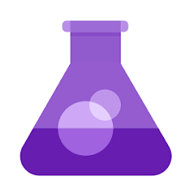

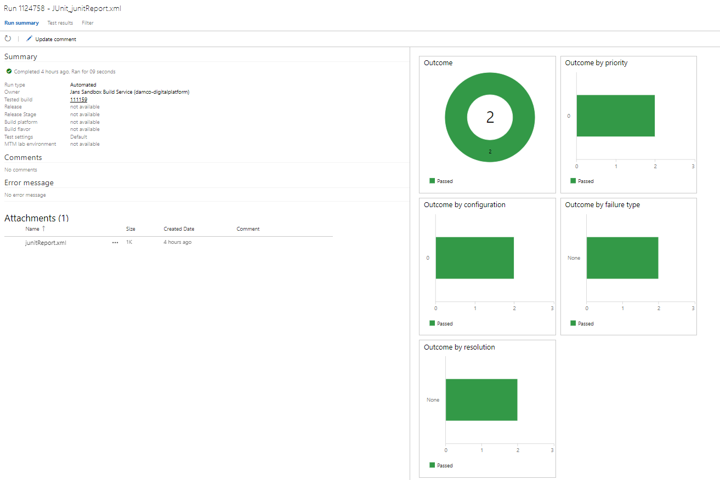
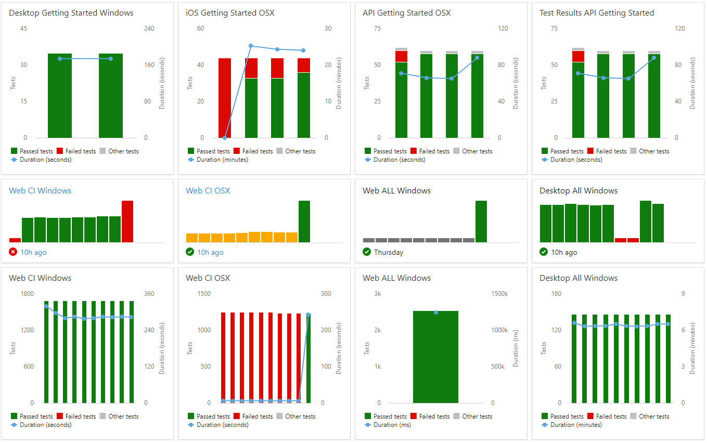
Test Automation Integration in Azure DevOps
Two ways of testing in Azure DevOps:
In Build Pipelines. Test scripts typically used for running unit test for each build. Requires test scripts checked into the repository. Exemplified by ‘B’ below.
In Test Plans. A Test Plan contains a set of test cases, which must be executed against a specfic build. Requires test scripts checked into the repository, and the test scripts must be linked to ADO test cases. Exemplified by ‘A’ below.
Git repository
Boards & work items
Test plans, setup
Pipelines
Run results
Test plans, reporting
A
B
C
D
Custom test case
Work item
test case
Test plan
Release
Test Case
Test Case
MS-hosted
test agent
Test Case
Test Case
Test Case
Postman
test case
Build
Test Case
MS-hosted
test agent
Test Case
Postman
test case
Test Case
Test Case
MSTest
test case
Work item
test case
Test plan
Release
Test Case
Test Case
MS-hosted
test agent
Test Case
Test Case
Test Case

